Slide 1
INVESTMENT CASE STUDY
SUBMISSION
Santhosh Kumar

Slide 2
<Abstract>
Spark Funds wants to make investments in a few companies. The CEO of Spark Funds wants to understand the global trends in investments so that she can take the investment decisions effectively.
Spark Funds has two minor constraints for investments:
It wants to invest between 5 to 15 million USD per round of investment
It wants to invest only in English-speaking countries because of the ease of communication with the companies it would invest in

Slide 3
<Problem solving methodology>
Use flow chart

Slide 4
<Analysis>

Slide 5
<Analysis>

Slide 6
<Analysis>

Slide 7
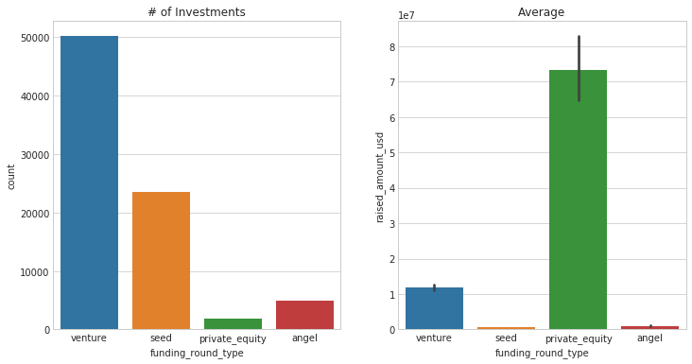
Fraction of total investments (globally) in venture, seed, and private equity, and the average amount of investment in each funding type
Venture has lot of investments and it also falls into the 5-15 million budget

Slide 8
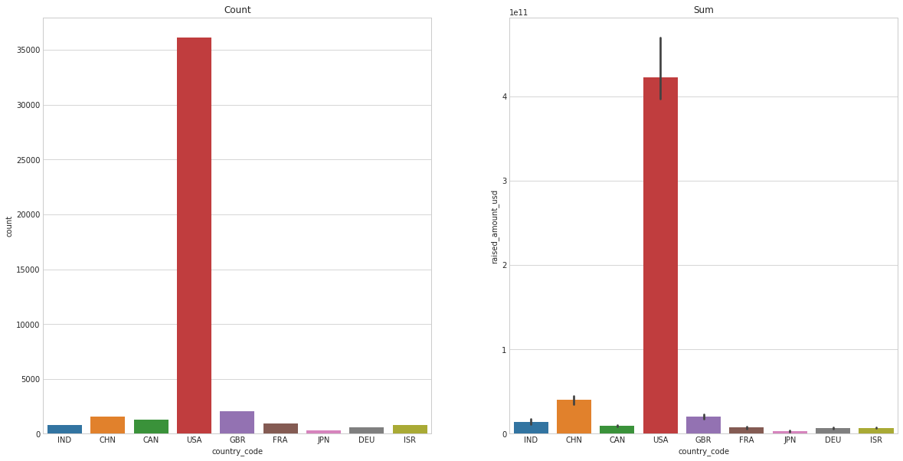
Top 9 countries against the total amount of investments of funding type “Venture”

Slide 9
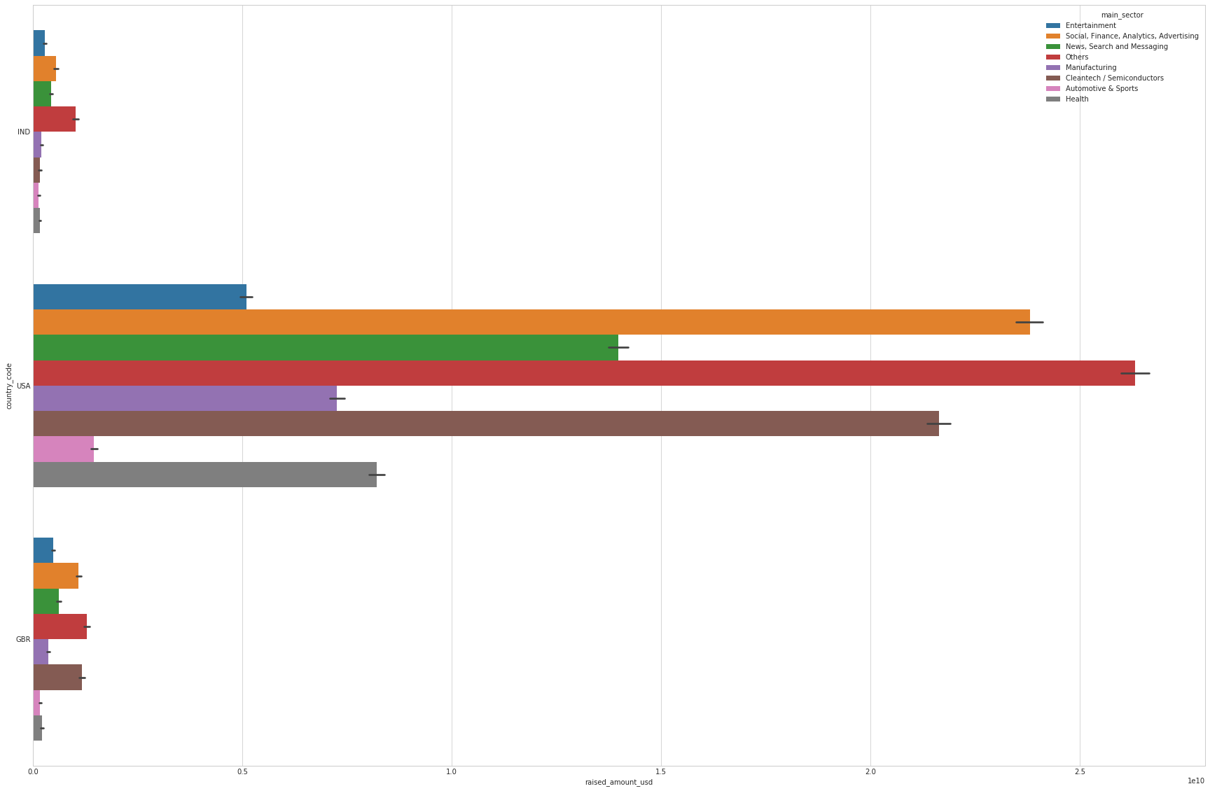
Investments in the top 3 sectors of the top 3 countries
<Results>

Slide 10
<Conclusions>

